Slide 1
ROSETTA-Ice Project
3 Campaign Seasons 2015-2016 2016-2017 2017-2018
43 Total Flights
~60,000 km (lines)
Radar Instruments: IcePod → Deep ICE (DICE) Radar Shallow Ice Radar (SIR)

Slide 2
Data Archive Structure
PLATFORM
Overarching directory structure for data archiving at LDEO.
Processed data occasionally contains additional directories for various processed data levels.
Theater
Campaign Year
Documents
PNT
Instrument
Line Seg File
trajectory
sensor
raw
processed

Slide 3
Headers for ALL Raw Data Files:
These headers are created as needed when signal is transmitted. Headers will be regenerated if there is brief signal loss, upon signal re-transmission.
Headers are named in the following format and contain the following information:
Theater ID _ Flight Number _ UTC YYYYMMDD _ UTC hhmmss _ 0000 . head
Institution Name:
UTC Date and Time of Header Creation: YYYYMMDD_hhmmss
Pod Operator: Initials of IcePod Operator during flight
Campaign ID: Theater Abbreviation & Number of IcePod Deployment to Theater (AN for Antarctica & ##)
Flight Number: ### Beginning From 001
Comments: Line Numbers, Flight Plans, Flight Numbers, etc.

Slide 4
Deep ICE (DICE) Radar
Phase Coherent Pulsed-Chirp VHF Radar Sounder Chirp Length: 1 μs and 3μs Bandwidth: 60 MHz Center Frequency: 188 MHz Resolution: Depth: <2 m | Along-track: 0.6 m Maximum Depth Penetration: ~ 5 km Total Data Collected: 60,000 Line km
raw |  |  | compressed |  |  | sar |  |  | decimated
Level 0 Header Raw Data Signal 10 Second Flight Data |  |  | Level 1 1μsCh1 & 3μsCh1 1μsCh2 & 3μsCh2 Config File Unfocused & Geolocated Data 1 Minute Flight Data |  |  | Level 1a 1μsCh1 & 3μsCh1 Config File Sar Processed Stack 01 8 Seconds ROSETTA-Ice Grid Line Data |  |  | Level 2 1μsCh1 & 3μsCh1 Config File 5 Minute (Averaged) Frame No. Identifier Added Corrections for Picking ROSETTA-Ice Grid Line Data
ROSETTA-Ice Project Campaign Seasons
2015 2016 | 2016 2017 | 2017 2018 | 2015 2016 | 2016 2017 | 2017 2018 | 2015 2016 | 2016 2017 | 2017 2018 | 2015 2016 | 2016 2017 | 2017 2018
2.875 TB | 1.383 TB | 1.532 TB | 17.409 TB | 3.903 TB | 6.106 TB | 7.245 TB | 4.945 TB | 5.025 TB | 450.00 GB | 287.50 GB | 312.50 GB

Slide 5
DICE Data Structure
stack01
compressed
Flight Data
icepod
stack01
antarctica
picks
sar
20152016
Line Picks Data
radar
raw
Flight Data
sir
dice
stack01
sar
Line Data
decimated

Slide 6
DICE Filename Structure
Flight Data
Theater ID | Flight No. | UTC Date | UTC Time | Pulse / Channel Frequency | Process Level | Sensor Type | [file format]
Antarctica (AN) + IcePod Deployment No. (##) | Flight Number (100#) = No. Times Deployed in Same Season (1) + No. of Flight (00#) | YYYY MM DD of Sample Collection | HH MM SS of Sample Collection | Pulse & Channel Configuration | Processing Level ID | Name or Abbreviation of Sensor Name for which this data belongs | Either . raw or .mat
Line Data
Campaign ID | ROSETTA-Ice Grid Line No. | UTC Date | UTC Time | Pulse / Channel Frequency | Process Level | Sensor Type | [file format]
Rosetta (RS) + Project Deployment No. (##) | L for E-W Grid Lines T for N-S Tie Lines Grid Numbers increase by 10 | YYYY MM DD of Sample Collection | HH MM SS of Sample Collection | Pulse & Channel Configuration | Processing Level ID | Name or Abbreviation of Sensor Name for which this data belongs | Usually .mat

Slide 7
DICE Processing (diceProcess.m)
diceProcess.m This is the top level function for processing Deep Ice Radar data. This script calls all functions required to process selected lines. All configurations for processing are set in "diceProcessConfig.m".
Level 0
Level 1
Level 1
Level 1
Level 1
Level 2
Level 2a
diceProcessConfig
dicePulseCompress
diceSingleSurf
diceGeoLocate
dicePreSarAssemble
diceSar1D
diceDecimateLevel2

Slide 8
DICE Processing (diceProcess.m)
Level 0
Level 1
Level 1
Level 1
Level 1a
Level 2
Level 2a
diceProcessConfig
dicePulseCompress
diceSingleSurf
diceGeoLocate
dicePreSarAssemble
diceSar1D
diceDecimateLevel2
Configuration Settings: 2500ft elevation, dataPath, Pulse Channel, Season #, Sensor Type, Chirp Period & Bandwidth, GPS & PNT data, etc.
Reads 10-Second Raw .dice Files
Parse 10-Sec Raw files, low pass filter, remove frequencies, convolve reference chirp with data, stacking, etc.
Creates 1-Minute Level 1 Mat Files.
Parse Level 1 Geolocated data, identify surface reflector from selected Channel, generate index variable with location of surface reflector within data.
Amends 1-Minute Level 1 Mat Files
Parse Level 1 Pulse Compressed data to stitch w/ Geolocation.
Amends 1-Minute Level 1 Mat Files
Rearrange Level 1 data so each file contains the same number of echoes required for SAR Processing - specified in diceProcessConfig.
Creates ‘tmp’ Folder w/ new Level 1 Mat Files
Parse PreSar Level 1 data. Computes migration curve using surface by default and ice refractive index. Three files loaded at a time to remove edge effects.
Creates 8-Second Level 2 Mat Files
Averages, decimates, and concatenates 1-Minute Level2 Files to create 5-Minute Level2a mat files for Bed Picking. Appends Filename w/ Frame No. 5-Minute Period determined in diceProcessConfig.m
Creates 5-Minutes Level 2a Mat Files w/ Frame Number

Slide 9
Shallow Ice Radar (SIR)
Frequency Modulated Continuous Wave (LFMCW) Chirp Length: 1 μs Bandwidth: 600 MHz Center Frequency: 2 GHz Resolution: Depth: 0.25 m | Along-track: 4 m Maximum Depth Penetration: ~ 450 m Total Data Collected: 60,000 Line km
raw |  |  | fft |  |  | decimated
Level 0 Header Raw Data Signal 10 Second Flight Data |  |  | Level 1 FFT & Geolocated Data Stack 04 1-Minute Flight Data ROSETTA-Ice Grid Line Data |  |  | Level 1a 5-Minute (Averaged) Frame No. Identifier Added Corrections for Picking ROSETTA-Ice Grid Line Data
ROSETTA-Ice Campaign Seasons
2015 2016 | 2016 2017 | 2017 2018 | 2015 2016 | 2016 2017 | 2017 2018 | 2015 2016 | 2016 2017 | 2017 2018
4.166 TB | 1.941 TB | 2.471 TB | 5.445 TB | 3.304 TB | 2.160 TB | 1.368 TB | 831.6 GB | 543.6 GB

Slide 10
SIR Data Structure
stack04
fft
Flight Data
icepod
Line Data
antarctica
decimated
20152016
stack04
radar
picks
fft
dice
sir
Line Picks Data
raw
Flight Data

Slide 11
SIR Filename Structure
Flight Data
Theater ID | Flight No. | UTC Date | UTC Time | Process Level | Sensor Type | [file format]
Antarctica (AN) + IcePod Deployment No. (##) | Flight Number 100# = No. Times Deployed in Same Season (1) + No. of Flight (00#) | YYYY MM DD of Sample Collection | HH MM SS of Sample Collection | Processing Level ID | Name or Abbreviation of Sensor Name for which this data belongs | Either . raw or .mat
Line Data
Campaign ID | ROSETTA-Ice Grid Line No. | UTC Date | UTC Time | Process Level | Sensor Type | [file format]
Rosetta (RS) + Project Deployment No. (##) | L for E-W Grid Lines T for N-S Tie Lines Grid Numbers increase by 10 | YYYY MM DD of Sample Collection | HH MM SS of Sample Collection | Processing Level ID | Name or Abbreviation of Sensor Name for which this data belongs | Usually .mat

Slide 12
SIR Processing (sirProcess.m)
sirProcess.m is the top level function for processing Shallow Ice Radar data. This script calls all functions required to process selected lines. All configurations for processing are set in "sirProcessConfig.m".
Level 0
Level 1
Level 1
Level 1
Level 1a
sirProcessConfig
sirFFTandMotionComp
sirPickSurf
sirLineBreaker
sirDecimateLevel1

Slide 13
SIR Processing (sirProcess.m)
Level 0
Level 1
Level 1
Level 1
Level 1a
sirProcessConfig
sirFFTandMotionComp
sirPickSurf
sirLineBreaker
sirDecimateLevel1
Configuration Settings: 2500ft elevation, dataPath, FFT type, Season Number, Sensor Type, Chirp Period & Bandwidth, GPS & PNT data, etc.
Reads 10-Second Raw .sir Files
Parse raw data, FFT, Geolocation, Motion Compensation, rvp correction, along-track dc signal removal, remove mean, stacking, etc.
Creates 1-Minute Level 1 Mat Files
Parse Level 1 Geolocated data, identify surface reflectors, generate index variable with location of reflectors in data.
Amends 1-Minute Level 1 Files
Break 1-Minute Level 1 Files from Flights to Lines. Loads ROSETTA-Ice Line Segment File and splits accordingly.
Duplicates and Renames 1-Minute Level 1 Files
Averages, decimates, and concatenates 1-Minute Level1 Files to create 5-Minute Level1a mat files for Bed Picking. Appends Filename w/ Frame No. 5-Minute Period determined in sirProcessConfig.m
Creates 5-Minutes Level 1a Files w/ Frame Number

Slide 14
Line Segment Files
These files are housed within season directories in a ‘projectlines’ directory. Line Segment files contain the start and end times of all ROSETTA-Ice Grid Lines and their associated Flights within the season. Initially written in ASCII format and then converted into .mat file to be read by processing scripts.
These files are named in the following format and contain the following information:
ICEPOD _ Season Years _ LINES . txt
FlightNum
LineNum
StartUTCDate
StartUTCTime
StartUnixTime
StopUTCDate
StopUTCTime
StopUnixTime
StartLatitude
StartLongitude
StartH-El
StopLatitude
StopLongitude
StopH-El
Project

Slide 15
GPS & PNT Trajectory Files
These PNT & GPS Trajectory Files are collected from a Novatel Span SE L1/L2 GPS Receiver on board the IcePod, and processed using Reigl Software. SPAN processing generates ASCII format files, which are then converted into .mat for processing.
These files are named in the following format and contain the following information:
Theater ID _ Flight Number _ UTC YYYYMMDD _ Sensor Name _ Product Level _ Processing Profile . txt
Datum (WGS84)
Antenna Height
Antenna Lever Arms
Body to Sensor Rotations
UTC Offset
UTCDate (MM/DD/YYYY)
UTCTime (sec)
UTCTime (HHMMSS.sss)
UTCTime (unixtime)
Latitude (degrees)
Longitude (degrees)
H-Ell (meters)
Pitch (degrees)
Roll (degrees)
Heading (degrees)

Slide 16
Picking Radar
Radar Picking uses MatLab scripts loosely based on MCoRDS Picking Scripts.
pickConfig.m
picker_Master.m
Data Input & Output Paths Input: 5-Minute Mat Files Frame Numbers Start & End Files to Pick Pick Type Visualization Window Additional Parameters
Filter Data Window Data Imports Config File Setup Output File Structure Auto Picker Selects Surface Auto Picker Sets Horizon: Rising, Falling, or Peak
Picked Data
Directory w/ Picker Name & Version of Pick
Frame-By-Frame JPGs: No Picks & Picks Overlain
Frame-By-Frame .Mat Files: All Variables from 5-Minute Mat Files
Stitched Survey Line .Mat Files Lightly Reduced in Data. Most Variables from 5-Min
Stitched Survey Line ASCII Files “Essential” Variables For Distribution
picker_ui.m
picker_display.m
Enables Keystroke Toggling Picking Boundaries / Params Pick Vertices Smooth Pick Lines Delete Recent Pick Vertices
Display Filters: Greyscale, Differenced, Greyscale Inverted, Smoothed Figure Axes Set Surface to Zero on Y-Axis Along-track Distance (km) Picking Borders / Params

Slide 17
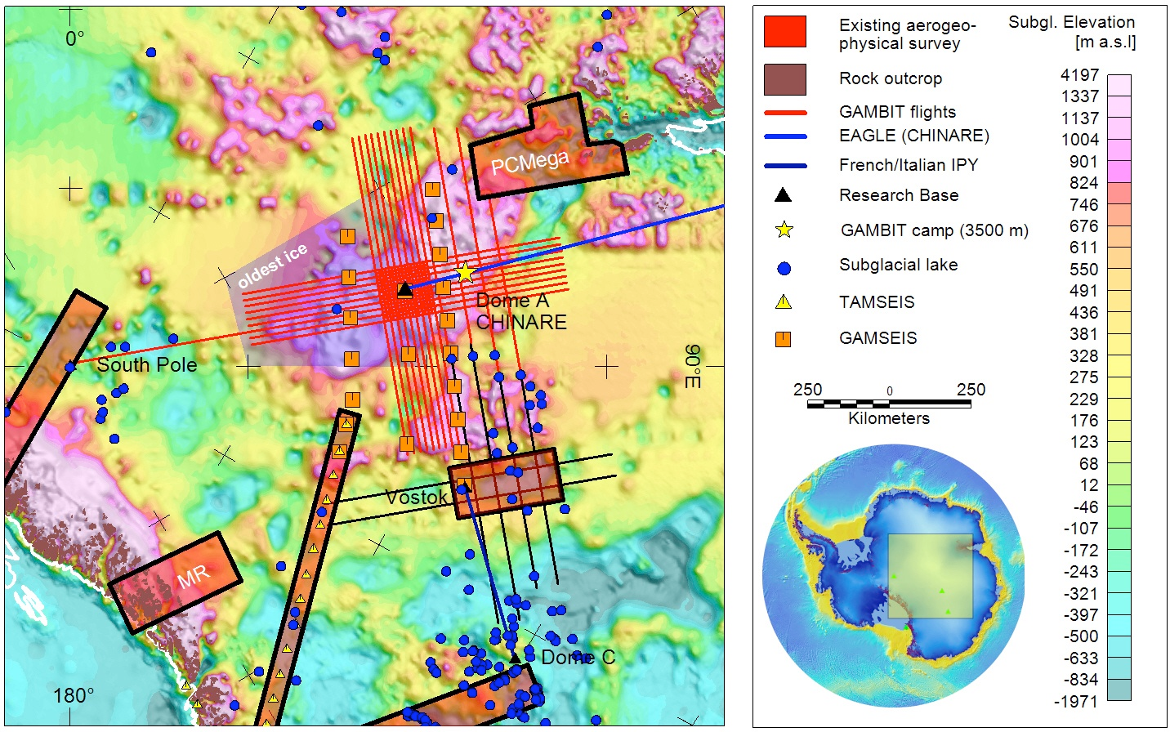
AGAP-GAMBIT Project

Slide 18
AGAP-GAMBIT Radar (CReSIS?)
Ultra Wideband Radar Bandwidth: 500 - 2,000 MHz | 600 - 900 MHz Center Frequency: 150 MHz Resolution: Depth: 150 m at 0.1 m | Depth: 150 m at 0.6 m Total Data Collected: 55,000 Line km
DataLevel_0 |  | DataLevel_1 |  | DataLevel_2 |  |  | DataLevel_3
Level 0 Raw Data Signal Geolocated Data (MAT-Files) ~30 Second (?) Flight Data No Header |  | Level 1 (MAT-Files) Pulse Compressed (Unfocused) 1D - SAR Processed 1 Minute Flight Data & Survey Lines ReadMe Files Available |  | Level 2 Ice Thickness Picks Derived From Level 1 Product Consolidated Picks CSV, XYZ, SHP Line-By-Line Picks SHP |  |  | Level 3 Gridded Products Currently MIA
Raw Data (.raw) | Geolocated Data (.mat) | Pulse Compressed (.mat) | 1D - SAR (.mat, .netcdf, & .segy) | Consolidated Picks (.csv, .xyz) | Consolidated Picks (.shp) | Line-By-Line Picks (.shp) | N/A
7.790 TB | ← included | 3.269 TB | 504 GB | 3.93 GB | 3.60 GB | 3.75 GB | N/A

Slide 19
AGAP Data Structure
Flight Number
FLIGHTS
GPS, GRAVITY, LASER, MAGNETICS, FLIGHT PLAN
DataLevel_0
Raw Data
RADAR
Flight Number
GRAVITY
dataGISMO, gpsGISMO
DataLevel_1
LIDAR
agap
DecimatedSAR (.mat)
MAGNETICS
DecimatedSAR_images
RADAR
DecimatedSAR_netcdf
DataLevel_2
DecimatedSAR_segy
PulseCompressed
RADAR
DataLevel_3
IceThicknessPicks
Gridded_Products.txt

Slide 20
All data is currently housed on an internal archive server called “hestia” Maintains intricate, overly specific directory and file naming structure.
ROSETTA processing scripts are held on an internal GITLab server.
Select Data is hosted on an external server called “wonder” and can be accessed via ROSETTA-Ice Data Page | PGG @ LDEO (pgg.ldeo.columbia.edu/data/rosetta-ice) or AGAP-GAMBIT | PGG @ LDEO (https://pgg.ldeo.columbia.edu/data/agap-gambit)
We do not currently have a map server or 3-D interpretation either Alexandra Boghosian working to get ROSETTA radar into HoloLens… So… maybe one day soon!

Slide 21
Seasons of data
Rosetta DICE - XX line km - YY TB
Rosetta SIR - XX line km - YY TB
AGAP? - XX line km - YY TB
Question about seasons: are formats and acquisition parameters the same for all seasons (but different for each radar) - I think this is the case
YES - not testing season, can adjust H-Ell window for high alt flights… don’t need this detail likely
DICE
.mat files
File size
File segment duration (5 mins?)
SIR
.mat files
File size
File segment duration (5 mins?)

Slide 22
Processing scripts
Done in matlab - master script and subscripts
SIR and DICE data arranged in consistent project-specific format on server
Data for RS seasons all in “version 2” (different from test seasons)
How long to process a flight on regular server?
Processing inputs
Data
PNT trajectory - standard format we output for Rosetta (same each time - right?)
Line endings table

